Slide 1

MACHINE LEARNING PROJECT

Slide 2
Tasks
CLASSIFICATION : SYMPTOMS AND COVID PRESENCE
REGRESSION : PIZZA PRICE PREDICTION

Slide 3
Task Outline
1. PROBLEM STATEMENT
2. SCOPE OF THE PROJECT
3.ARCHITECTURE/METHODOLOGY/ALGORITHM
4. DATASET DESCRIPTION
5. EVALUATION MEASURES
6. EXPERIMENTAL RESULTS
7. CONCLUSION

Slide 4
Problem Statement
CLASSIFICATION : SYMPTOMS AND COVID PRESENCE
The problem statement of this project is to build a classification model that can predict if COVID-19 is possibly present or not based on the given symptoms. The project aims to use machine learning techniques to aid in the diagnosis of COVID-19, which can be helpful for healthcare professionals in identifying potential COVID-19 cases and taking appropriate measures. The dataset contains various symptoms and their corresponding labels, indicating whether or not the patient has COVID-19. The goal of the project is to develop a reliable and accurate model that can predict COVID-19 based on the symptoms provided.

Slide 5
Scope of Project
The project aims to create a machine learning model that can accurately predict whether a patient has COVID-19 based on their symptoms. The success of the project will depend on the quality of the dataset used, the appropriate selection of machine learning algorithms, and the proper evaluation of the model's performance. This model can help healthcare professionals in diagnosing COVID-19, leading to timely treatment and reduced disease spread. Additionally, a user-friendly application can be developed to help the general public in self-diagnosing and taking necessary precautions. The project's success can have a significant impact on the healthcare industry by improving the efficiency and accuracy of COVID-19 diagnosis.

Slide 6
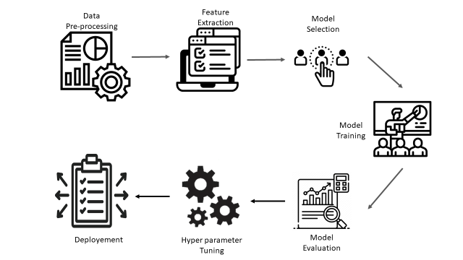
Architecture Diagram

Slide 7
Dataset of Project
The dataset for the project to develop a machine learning model to predict the possibility of COVID-19 based on symptoms should include a large number of cases with symptoms and COVID-19 status. The data should be collected from reliable sources such as hospitals, clinics, testing centres, or online surveys.
The dataset should be pre-processed and cleaned to remove any outliers or missing data. It should also be split into training and testing datasets to evaluate the performance of the machine learning model.
The dataset can also be augmented by including data from other sources such as social media or news reports to provide a broader context of the COVID-19 outbreak.

Slide 8
Evaluation Measures
The evaluation of the classification model can be performed using various performance metrics, depending on the specific requirements and goals of the project. Some of the commonly used evaluation measures for the classification of COVID-19 include:
Accuracy
Precision and Recall
F1 Score
ROC Curve and AUC
Confusion Matrix
The selection of the appropriate evaluation metrics will depend on the project's specific requirements and goals, and a combination of these metrics can be used to provide a comprehensive evaluation of the model's performance.

Slide 9
Problem Statement
REGRESSION : PIZZA PRICE PREDICTION
The problem statement of the above project is to predict the price of a pizza based on its company, diameter, topping, variant size, extra sauce, and extra cheese using regression techniques. The aim is to build a model that can accurately predict the price of a pizza given its attributes.

Slide 10
Scope of Project
The scope of the above project is to build a regression model to predict the price of a pizza based on various features such as company, diameter, topping, variant size, extra_sauce, and extra_cheese. The project involves performing the required preprocessing on the dataset, constructing a regression model using two algorithms, and evaluating the model using suitable measures. The project also includes a comparison analysis of the results obtained from the two algorithms used. The ultimate goal is to build an accurate regression model that can predict the price of a pizza with a low error rate.

Slide 11
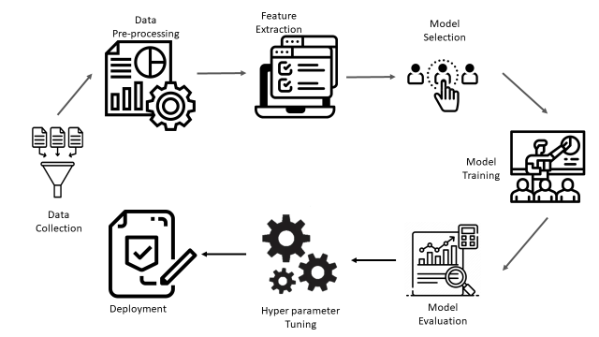
Architecture Diagram

Slide 12
Dataset of Project
The dataset for the above project contains information about pizzas and their prices. The dataset has both categorical and numerical variables. The categorical variables are Company, Topping, Variant, Size, Extra_sauce, and Extra_cheese. The numerical variable is Diameter. The target variable, Price, is also numerical. The dataset may require preprocessing before it can be used for regression analysis.

Slide 13
Evaluation Measures
The evaluation measures for the above project, which involves predicting the price of a pizza using regression techniques, can include:
Mean Squared Error (MSE)
Root Mean Squared Error (RMSE)
R-squared (R2)
Mean Absolute Error (MAE)
Mean Absolute Percentage Error (MAPE)
The choice of evaluation measures will depend on the specific problem and the business requirements. It is important to use multiple measures to assess the model's performance from different perspectives.

Slide 14
Conclusions
In conclusion, both projects involved building machine learning models using classification and regression techniques. The projects had different scopes and datasets, but they shared similar steps such as data pre-processing, model training, and model evaluation. The choice of evaluation measures was also similar for both projects, and it was important to choose multiple measures to assess the model's performance from different perspectives.

Slide 15
THANK YOU
K Uday Kiran 20W1A1293
P Monica 208W1A12A5
P Devi Divya Sri 208W1A12A9

